Slide 1

EDA REPORT
FOR UFC
DATASET ANALYSIS

Slide 2

INTRODUCTION
This presentation will pose some questions and will try to answer them through some EDA-driven stories.

Slide 3
ESTABLISHING QUESTIONS
1. What are the most popular locations where UFC hosts its events?
2. What is the historical average number of UFC events hosted annually?
3. What are the top fight outcomes?
4. Does being in a particular corner contribute to a victory?
5. Does having a specific fighting stance contribute to a victory?
6. What are the main fight tactics contributing to a victory?
7. Do any specific anthropometric features (like height, reach, etc.) contribute to a victory?
8. Based on the findings, can we use the information to bet on a fighter?

Slide 4

UNDERSTANDING THE DATA

Slide 5
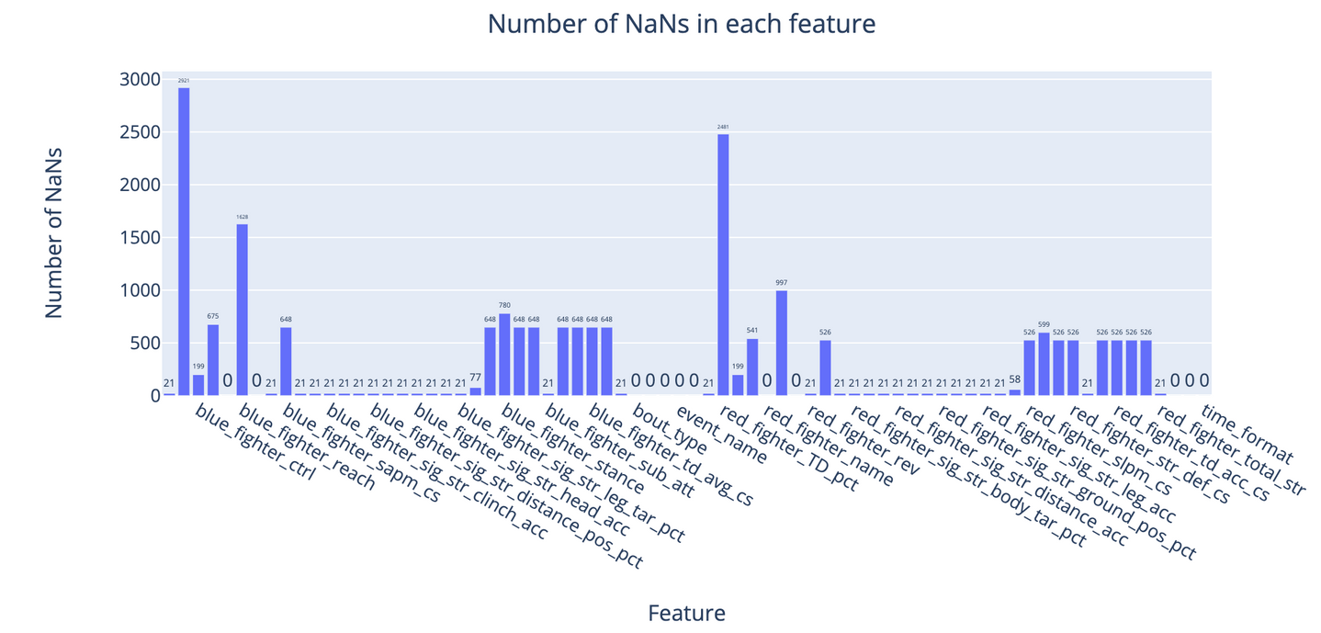
Missing data
Findings
54% of the features have NaN entries
53% of these NaN features have 21 NaN entries, the rest ranges from 2% to 37% of NaN entries
68% of the total pool of NaN entries are directly in the dataset as NaN, and the remaining 32% are in the form of NaN placeholders, like “-”, “---”, etc.
54% of the pool of NaN placeholders like “-”, “---”, etc. are actually NaN placeholders, and the rest 46% of the pool is just 0s, as the reason is not that the data was recorded but not entered, but in fact, was not recorded, e.g. a fighter did not land any strikes.

Slide 6
UNIVARIATE ANALYSIS

Slide 7
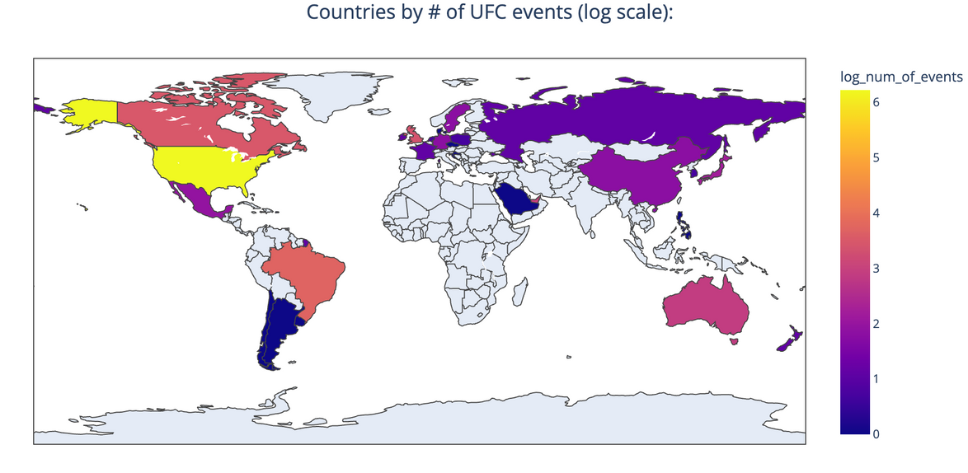
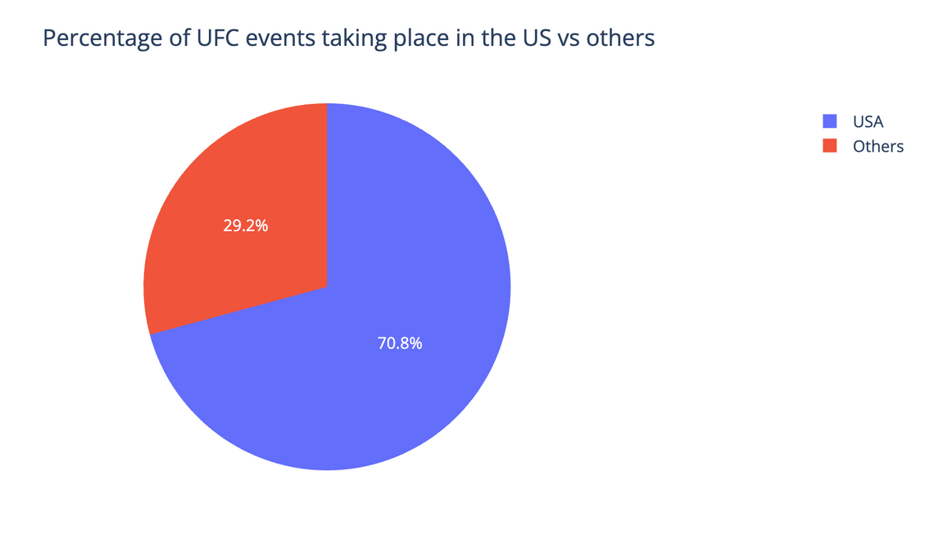
Question #1. What are the most popular locations where UFC hosts its events? (Countries)
Findings
The US takes 70.8% of the total pool of the countries, where UFC events were hosted
Followed by Brazil, Canada, The UK, UAE, Australia, Japan, Mexico, Germany, China, Sweden, Singapore, New Zealand, Russia, Ireland, France, South Korea, Poland, Netherlands, Saudi Arabia
Factors like regulation, culture, fanbase, location, infrastructure, government support and others affect these rankings

Slide 8
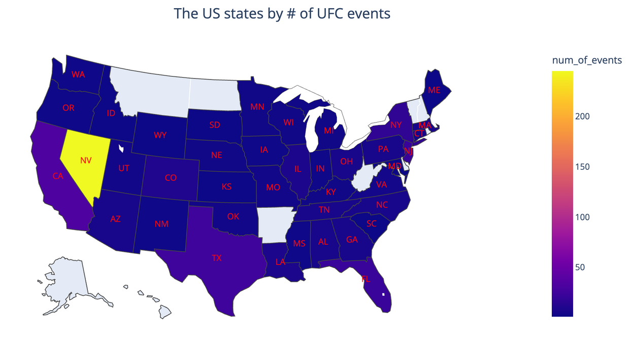
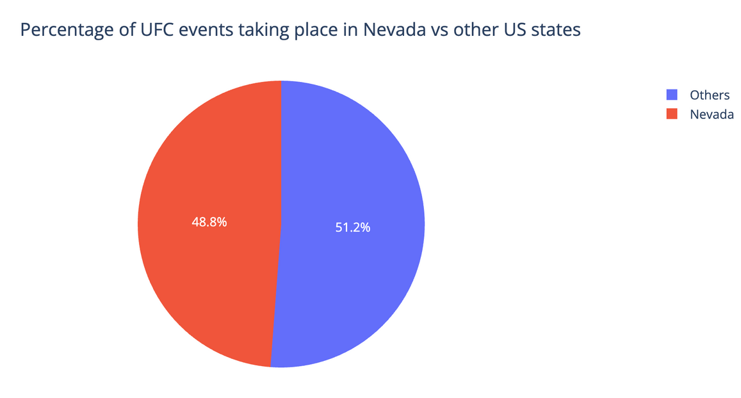
Question #1. What are the most popular locations where UFC hosts its events? (States)
Findings
Nevada, the fight capital of the world, takes 48.8% of the total pool of states
Followed by California, Texas, Florida, New Jersey, New York, Colorado, Louisiana, Illionois, North Carolina, Massachusetts, Tennessee, Ohio and others.
Factors like the cultural role, regulation, fanbase, “status” and media perception, population, and others affect these rankings.

Slide 9
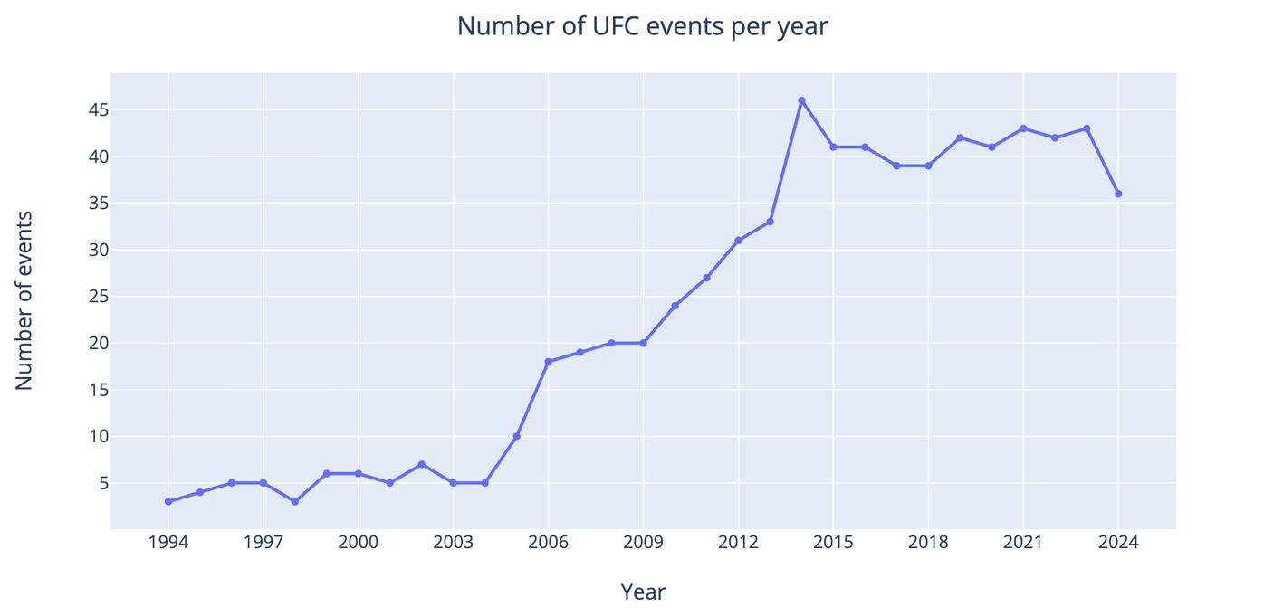
Question #2. What is the historical average amount of UFC fights hosted annually?
Findings
UFC started out with initial steady growth throughout 1995-2004 with an average of 4 annual events
Then, the 2005-2010 rapid growth period was fueled by a deal with Spike TV to broadcast the Ultimate Fighter show, at the same time UFC was starting to being taken as a legitimate sports property.
In 2011-2014 UFC entered Brazil, Asia, and Europe. Led to a jump of from 27 events annually to 46.
In 2015-2019 UFC signed a deal with ESPN, ended up in ~40 events on average
In 2020-2021, the covid era, but UFC did well due to having build UFC Apex, their custom fighting arena, as well as Abu Dhabi’s Fight Island.
In 2021-2024 shows how fast UFC normalized their events, Florida being the first state to allow to resume hosting events.
The 2024 period is not finished yet, but expected to meet the average of previous years.

Slide 10
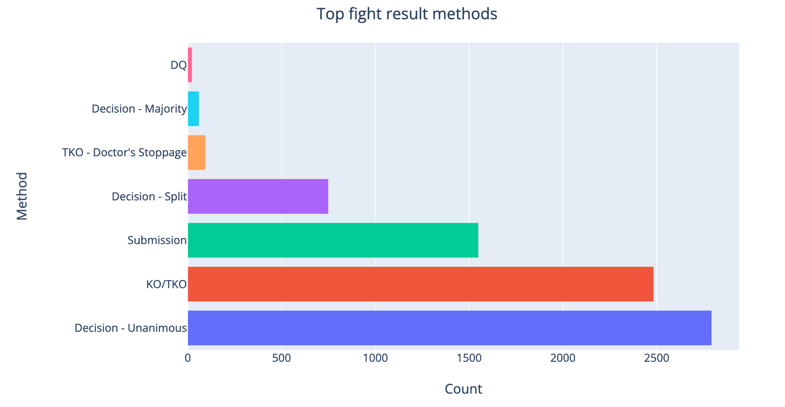
Question #3. What are the top fight outcomes?
Findings
Decision-Unanimous is the top 1, followed by KO/TKO at #2, followed by Submission at #3, followed by Decision-Split, TKO-Doctor’s Stoppage, Decision-Majority, DQ
Reasoning is that it’s much easier to win on points than by a KO/TKO, as a fighter can just “play it safe”, then there’s more KO/TKOs than Submissions because there’s more strikers than wrestlers, and there’s much more striking time in fights than wrestling.
Non-unanimous decisions, along with Doctor’s stoppage, are at the end because the judges are incentivized to give a clear winner

Slide 11
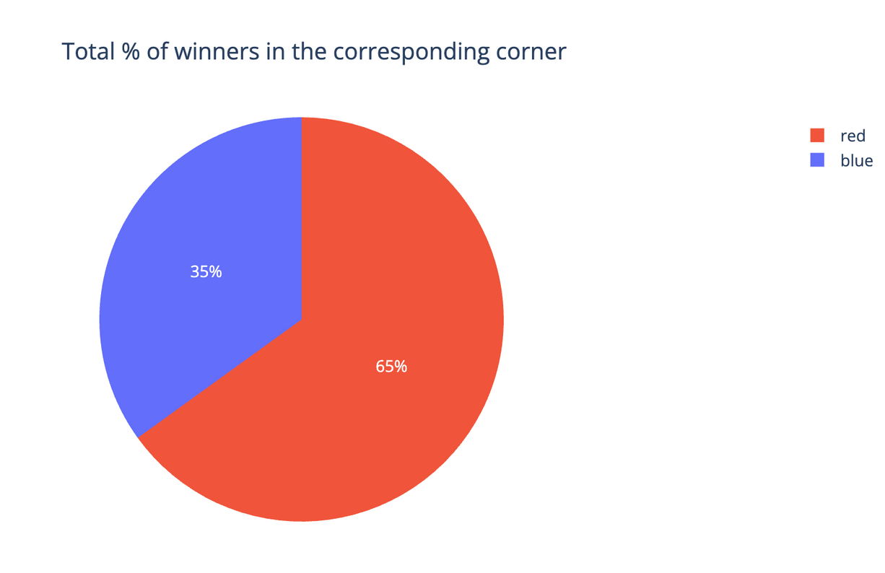
Question #4. Does being in a particular corner contribute to a victory?
Findings
Fighters from the red corner win 65% of the time, whereas fighters from the blue corner win only 35% of the time
The reasoning here is that the red corner is given to champions and higher-ranked fighters, whereas the blue corner is given to the contenders and lower-ranked fighters.

Slide 12
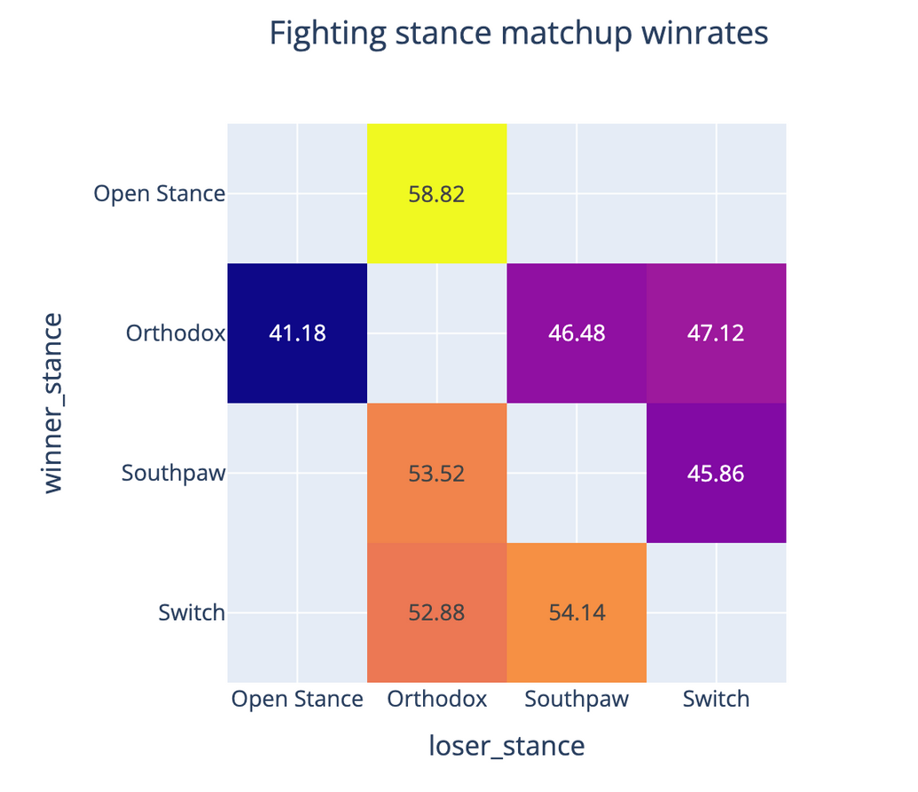
Question #5. Does having a specific fighting stance contribute to a victory?
Findings
Yes, it does contribute. The ranking is as the following: Switch > Southpaw > Orthodox. Open Stance is not included because the stance is too rare, and there’s too small of a sample size to draw any conclusions
The reasoning here, is that the rarer a fighter’s stance is, the trickier and more uncomfortable it is to fight that person because of how practice-based this sport is.
There’s around 80.3% of orthodox fighters, 17.4% southpaws and 2.3% of other stances

Slide 13
MULTIVARIATE ANALYSIS

Slide 14
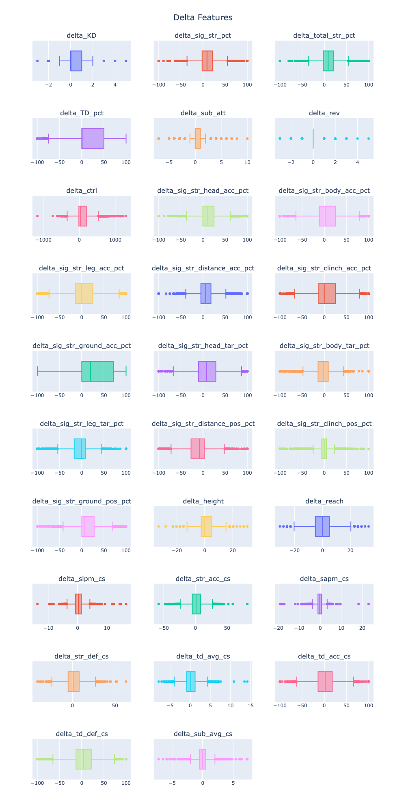
Question #6. What are the main fighting aspects contributing to a victory? Boxplots.
Findings
None of the features except two seem to be undersampled from this quick boxplot chart over all the numerical features
That means, we can run Kohen’s D on these non-undersampled features to try and rank them

Slide 15
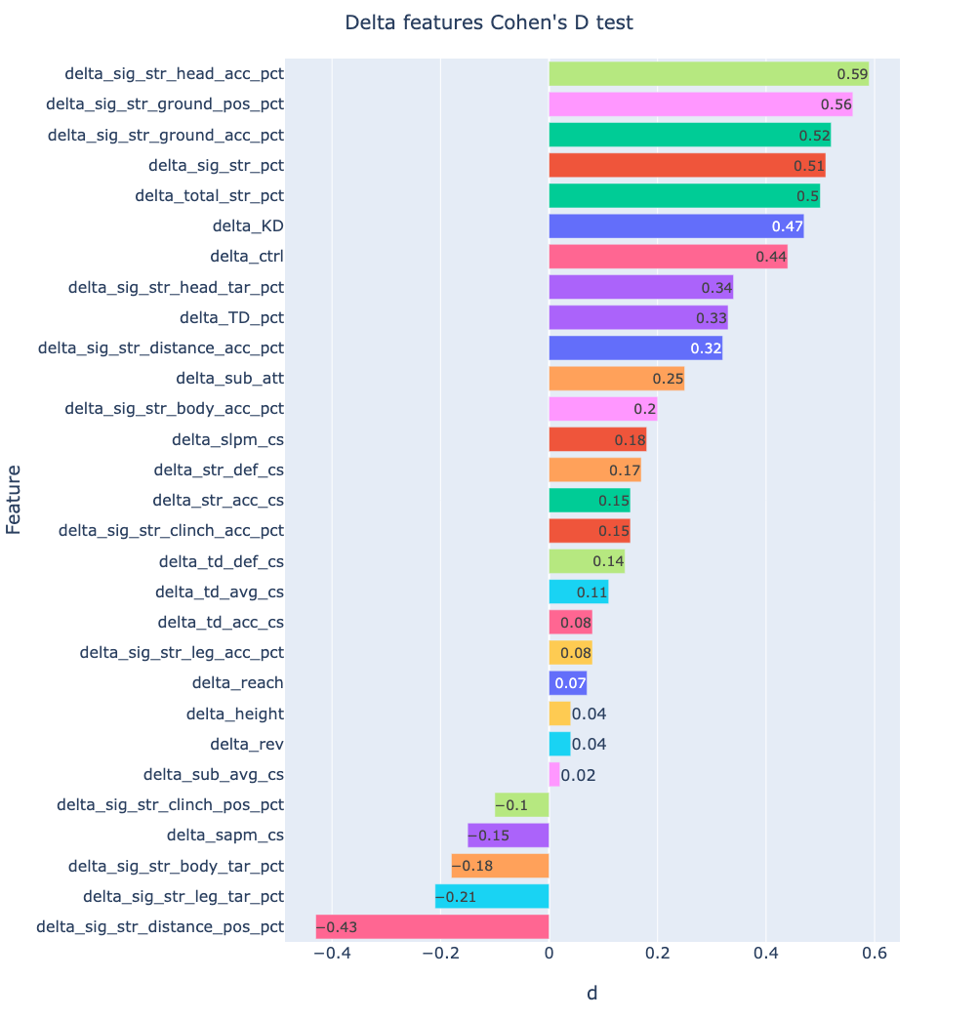
Cohen’s D on performance-based features
Findings
Some of the most important features are: accuracy of sig. str. to the head, accuracy of sig. str. from the ground position, targeted sig. str. in the ground position, and others.
Some of the features on medium importance scale are: takedowns, submission attempts, sig. str. from clinch, and others.
Some of the features that negatively contribute to winning are: sig. str. from distance position, targeted sig. str to the legs, and others.

Slide 16
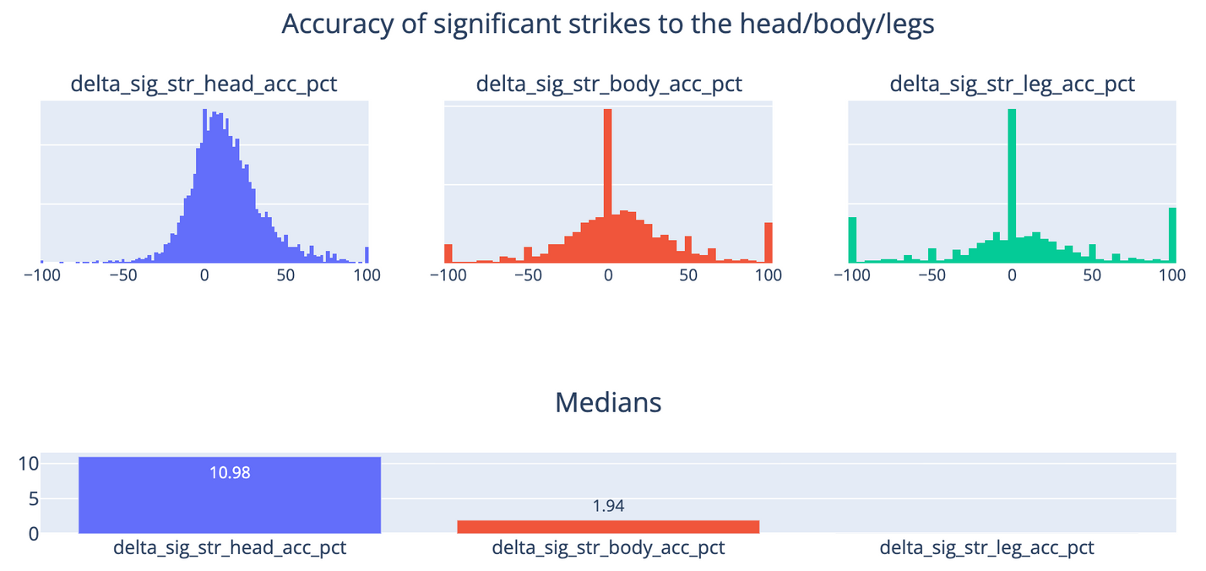
Accuracy of significant strikes to the head/body/legs
Findings
Accurate sig. str. to the head hint on being important in winning, followed by sig. str. to the body having a smaller importance, ending with strikes to the legs showing no significant connection to winning.
But accuracy alone is not a reliable predictor of winning in fights, as a fighter may not be better on accuracy and instead, win on volume.
Conclusion: Head > body > legs

Slide 17
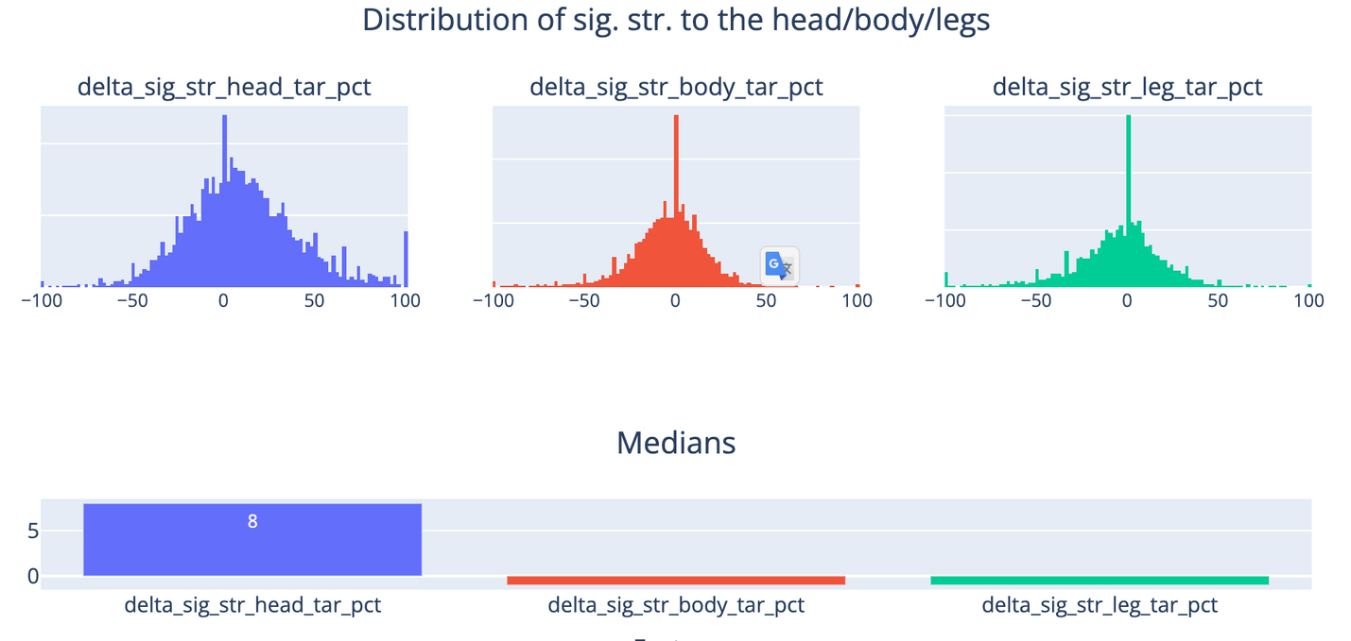
Distribution of sig. str. to the head/body/legs
Findings
Winners prefer targeting their significant strikes to the head > body = legs.
Head targeting is the key differentiator for winning, whereas sig. str. to the body/legs seem to be less important but nonetheless, it's not like winners don't go for these targets, we can see in the num. of outliers; So they still are valuable, but yield value rather in the long run, on the other hand, head strikes are more visible, lead to cuts, thus showing significant damage, sway judges, and lead to KDs / finishes.
Conclusion: Head > body = legs

Slide 18
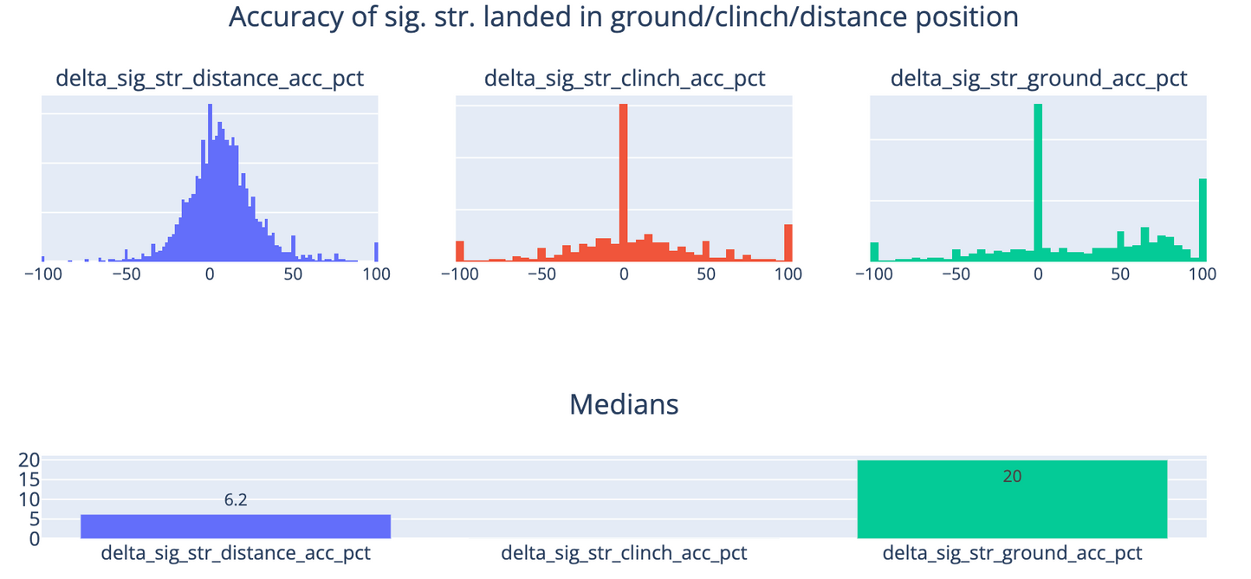
Accuracy of sig. str. landed in ground/clinch/distance position
Findings
Ground strikes are the most effective, with high accuracy and impact.
Distance strikes have a positive median but less impact.
Clinch strikes show low accuracy and effectiveness.
Training styles affect striking, with distance strikes being universal.
Ground strikes are crucial for winning, followed by distance strikes; clinch strikes are least effective.
Conclusion: Ground > Distance > Clinch

Slide 19
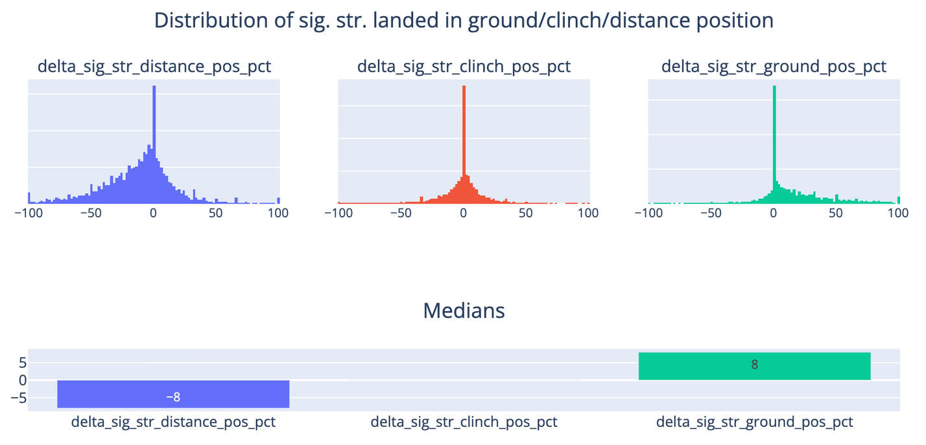
Distribution of sig. str. landed in ground/clinch/distance position
Findings
Significant striking from the ground position is crucial for winning, supporting the idea that “on average, wrestlers beat strikers.”
Several factors contribute to changes in outcomes:
The feature's calculation distributes strikes across three positions, affecting other features.
Most fighters strike from a distance, while fewer strike from positions like the ground due to the lower number of wrestlers.
Winners tend to strike from the ground or clinch for safety and control.
Conclusion: Ground > clinch > distance.

Slide 20
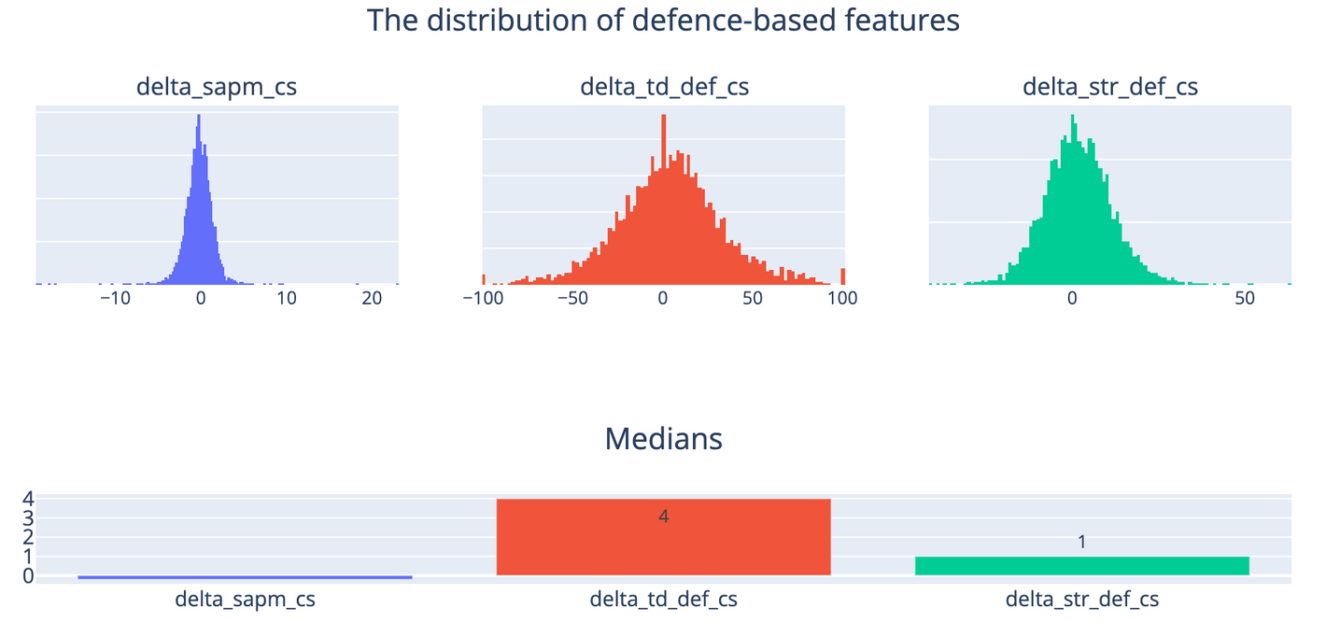
The distribution of defence-based features
Findings
SAPM (Significant Strikes Absorbed per Minute): Lower values are better. Median is around 0, but winners often have lower SAPM. This isn't definitive due to many close or stance-end fights.
Takedown Defense: Has the highest median and links to winning, especially for strong wrestlers.
Striking Defense: Shows a slight positive skew, centered around 0, not a strong winning predictor.
Conclusion: Takedown defense is more crucial than striking defense and SAPM.

Slide 21
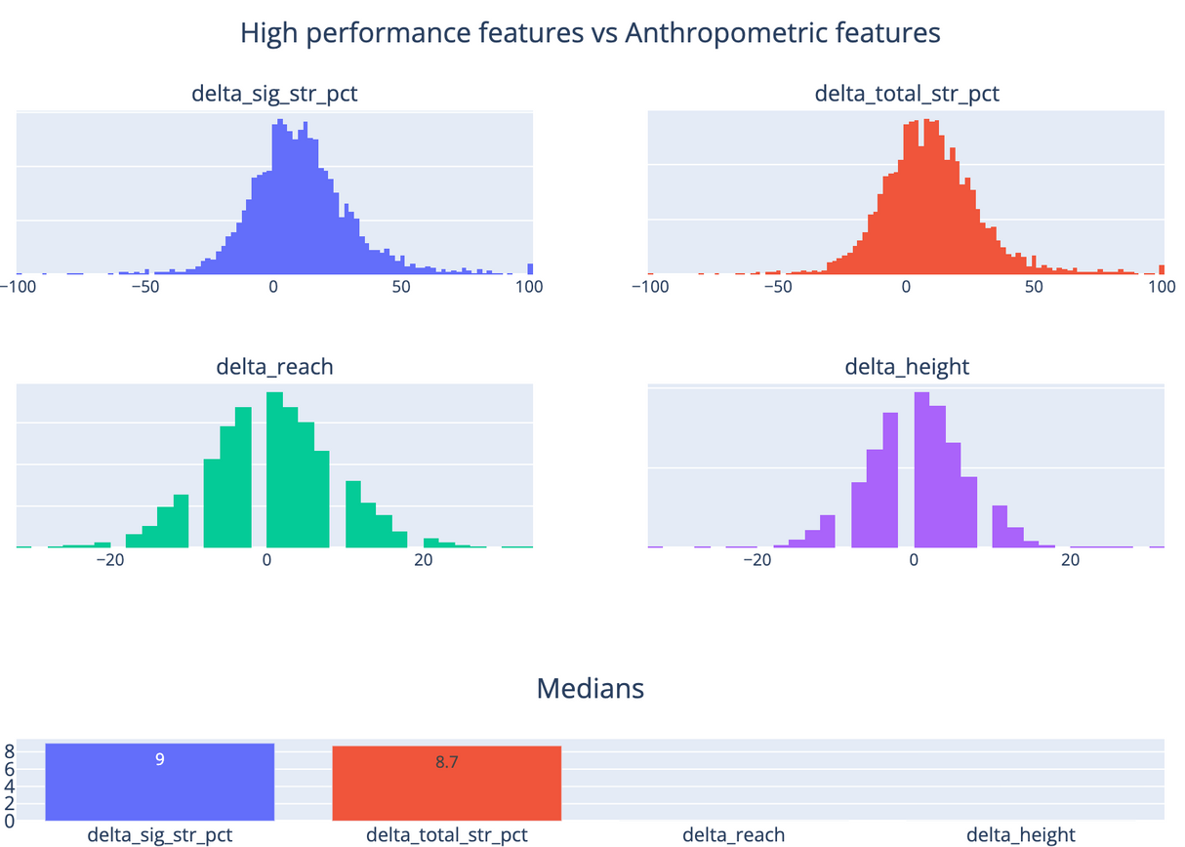
Question #7. Do any specific anthropometric features (like height, reach, etc.) contribute to a victory?
Findings
Anthropometric features like reach and height generally do not provide a clear advantage to fighters, except in certain matchups. In striking, taller fighters or those with longer reach often outperform shorter fighters. However, in MMA, wrestlers—who tend to be shorter and have shorter reach—can defeat strikers, balancing the advantage.
Conclusion: sig_str = total_str > reach = height

Slide 22
Question #8. Based on the findings, can we use the information to bet on a fighter?
Findings
MMA is matchup-based, with no guaranteed winning factors. Key betting insights include:
Focus on wrestlers who control fights on the ground, landing strikes, and demonstrating strong takedown defense.
Prioritize fighters who target the head, as this leads to wins, cuts, and KOs.
Avoid betting on fighters who only strike from a distance, lack wrestling skills, or focus on body/leg strikes, as they tend to have less control and visual dominance in fights.

Slide 23

Presented By : @komaksym
THANK YOU

